Slide 1

Group 5 Spring Break Vacation Decision Analysis Under Uncertainty
Welcome
March 12th, 2022

Slide 2
Agenda
Group 5 Introduction
Project Objective
Uncertainty Scenarios
Data Evaluation
Evaluation Methods/Measures
Decision Criteria/Alternatives
Figural Models
Sensitivity Analysis
Next Steps

Slide 3

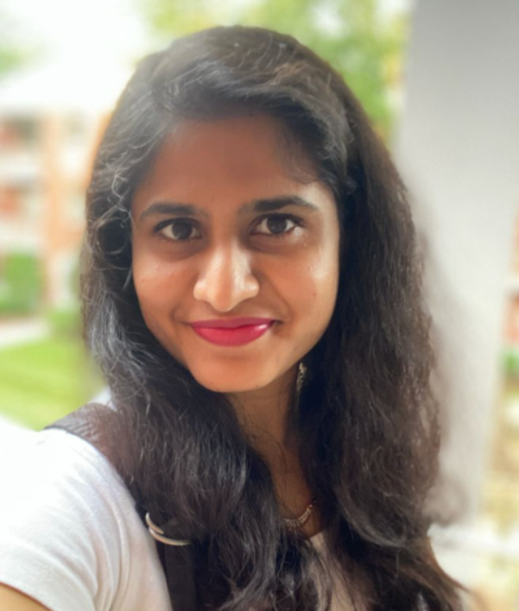

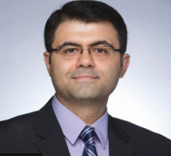
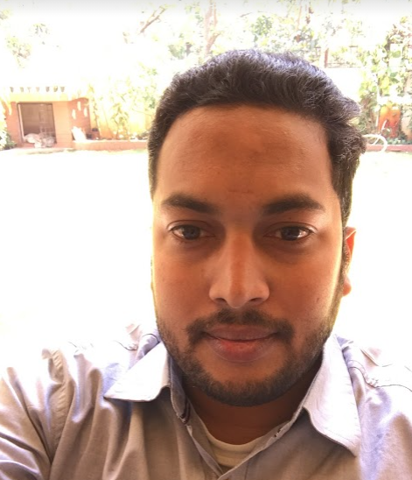
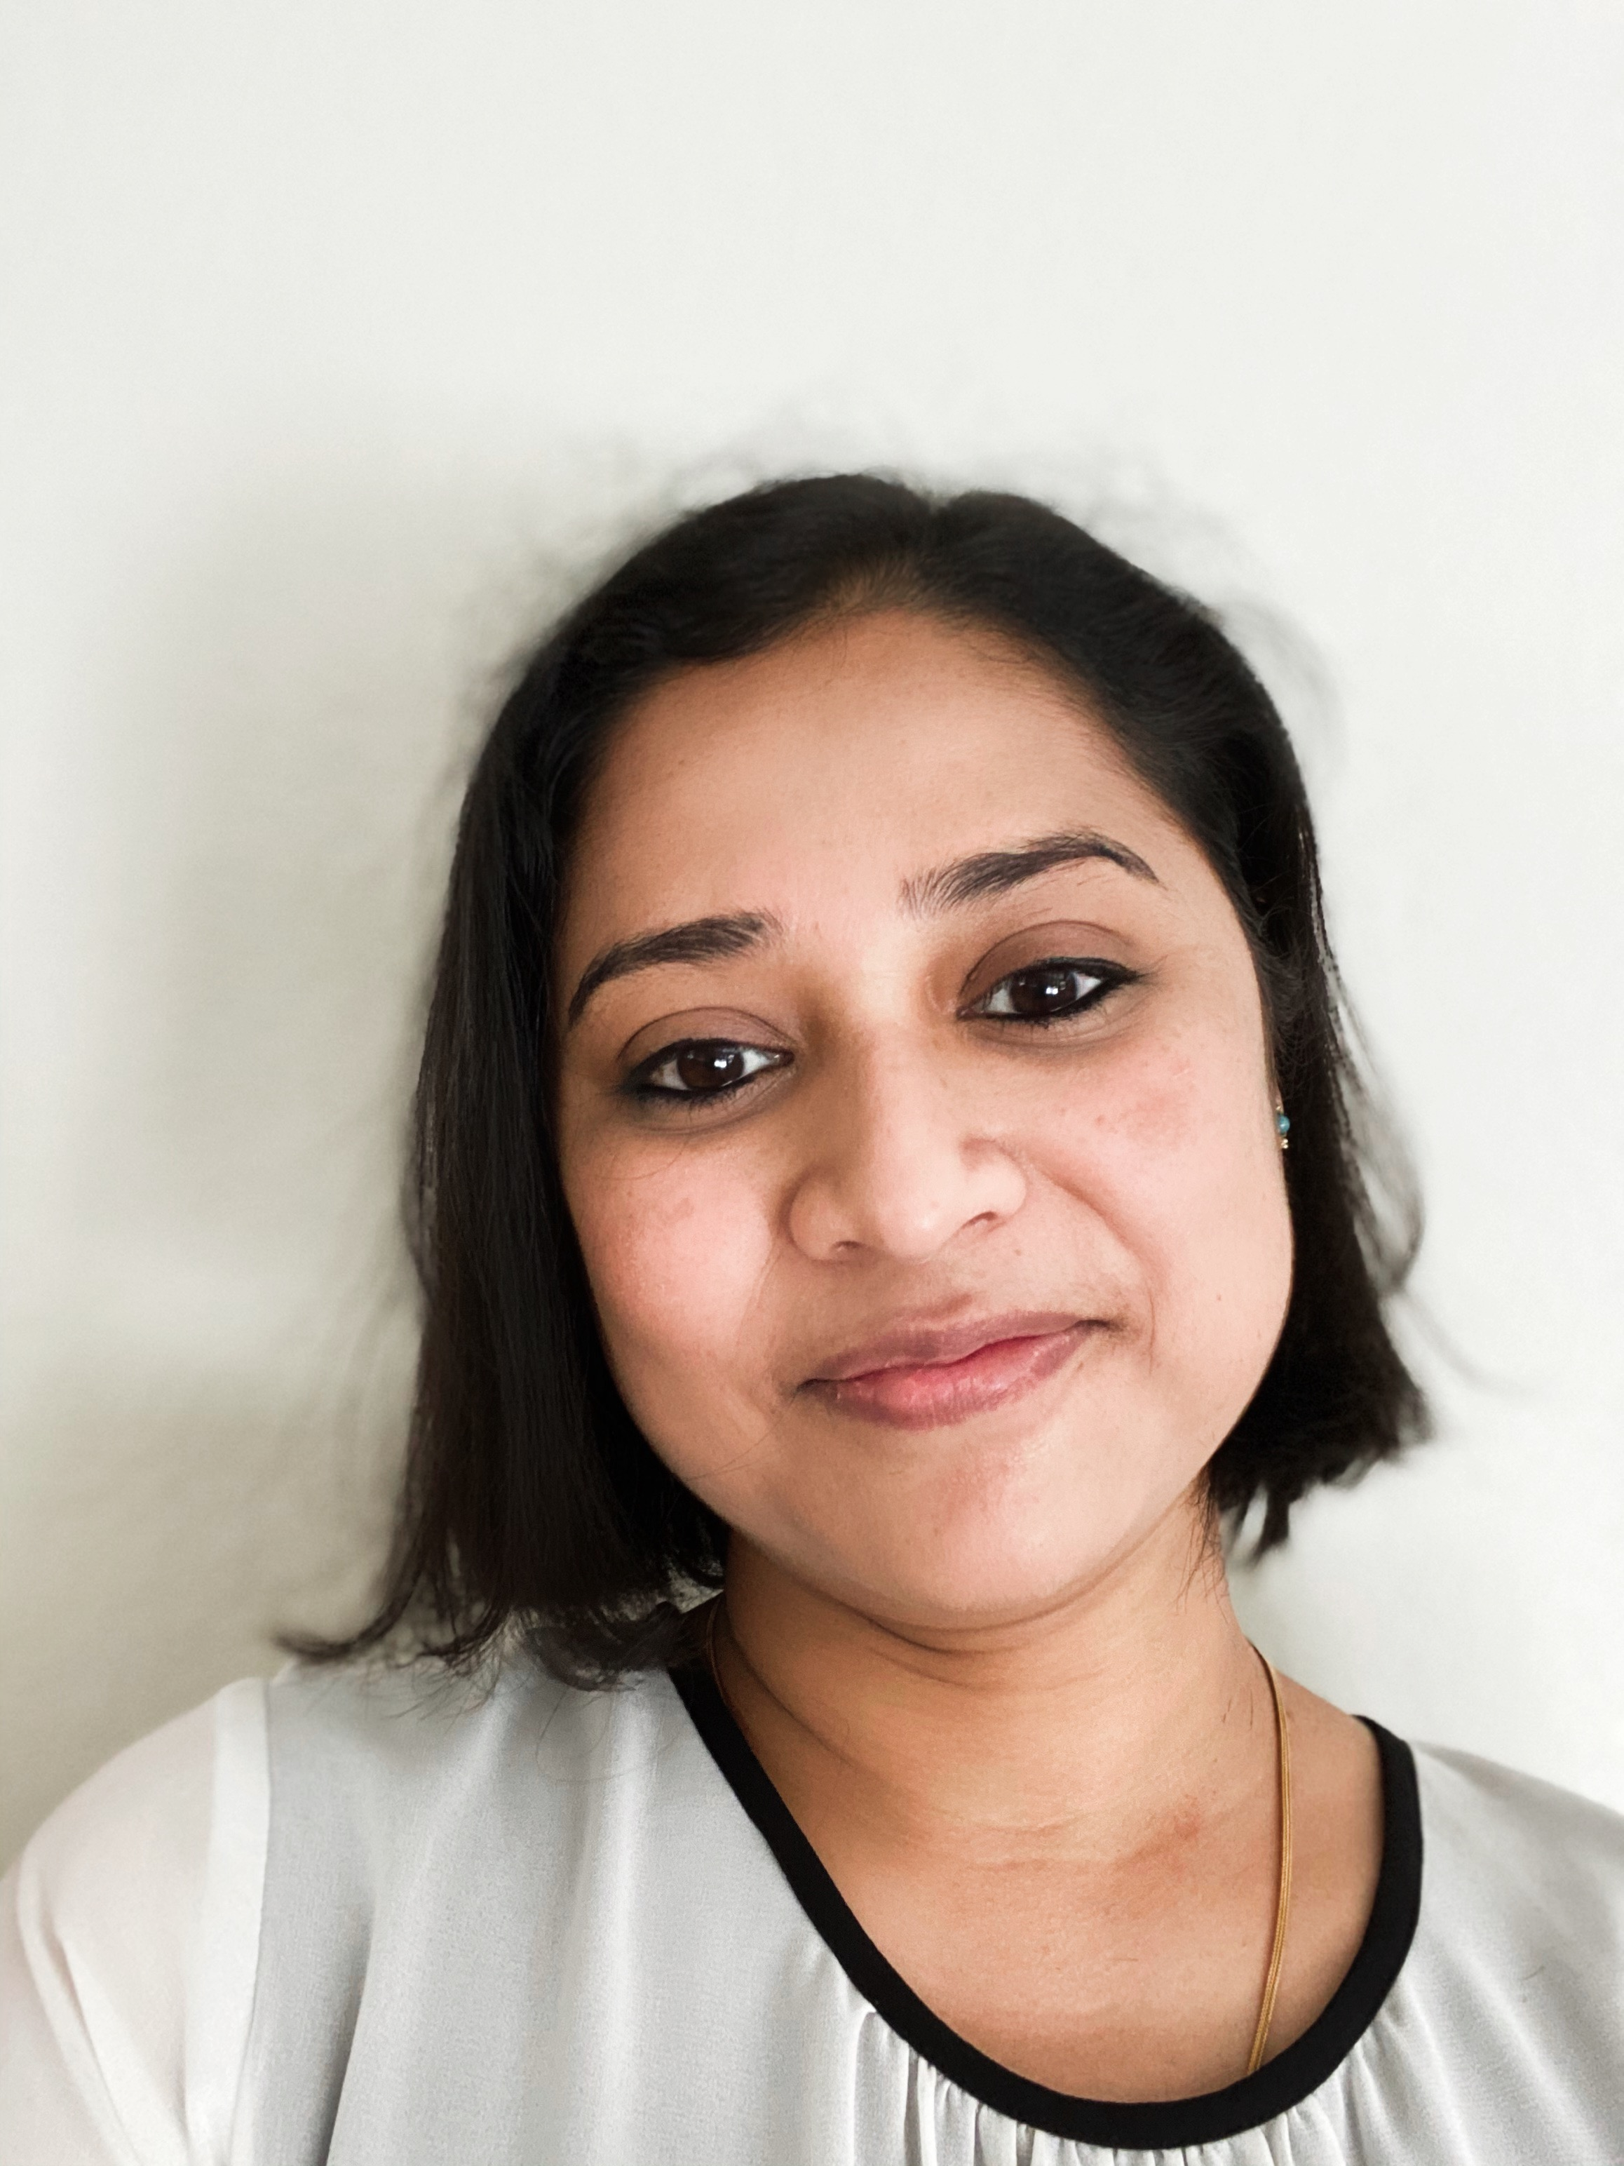
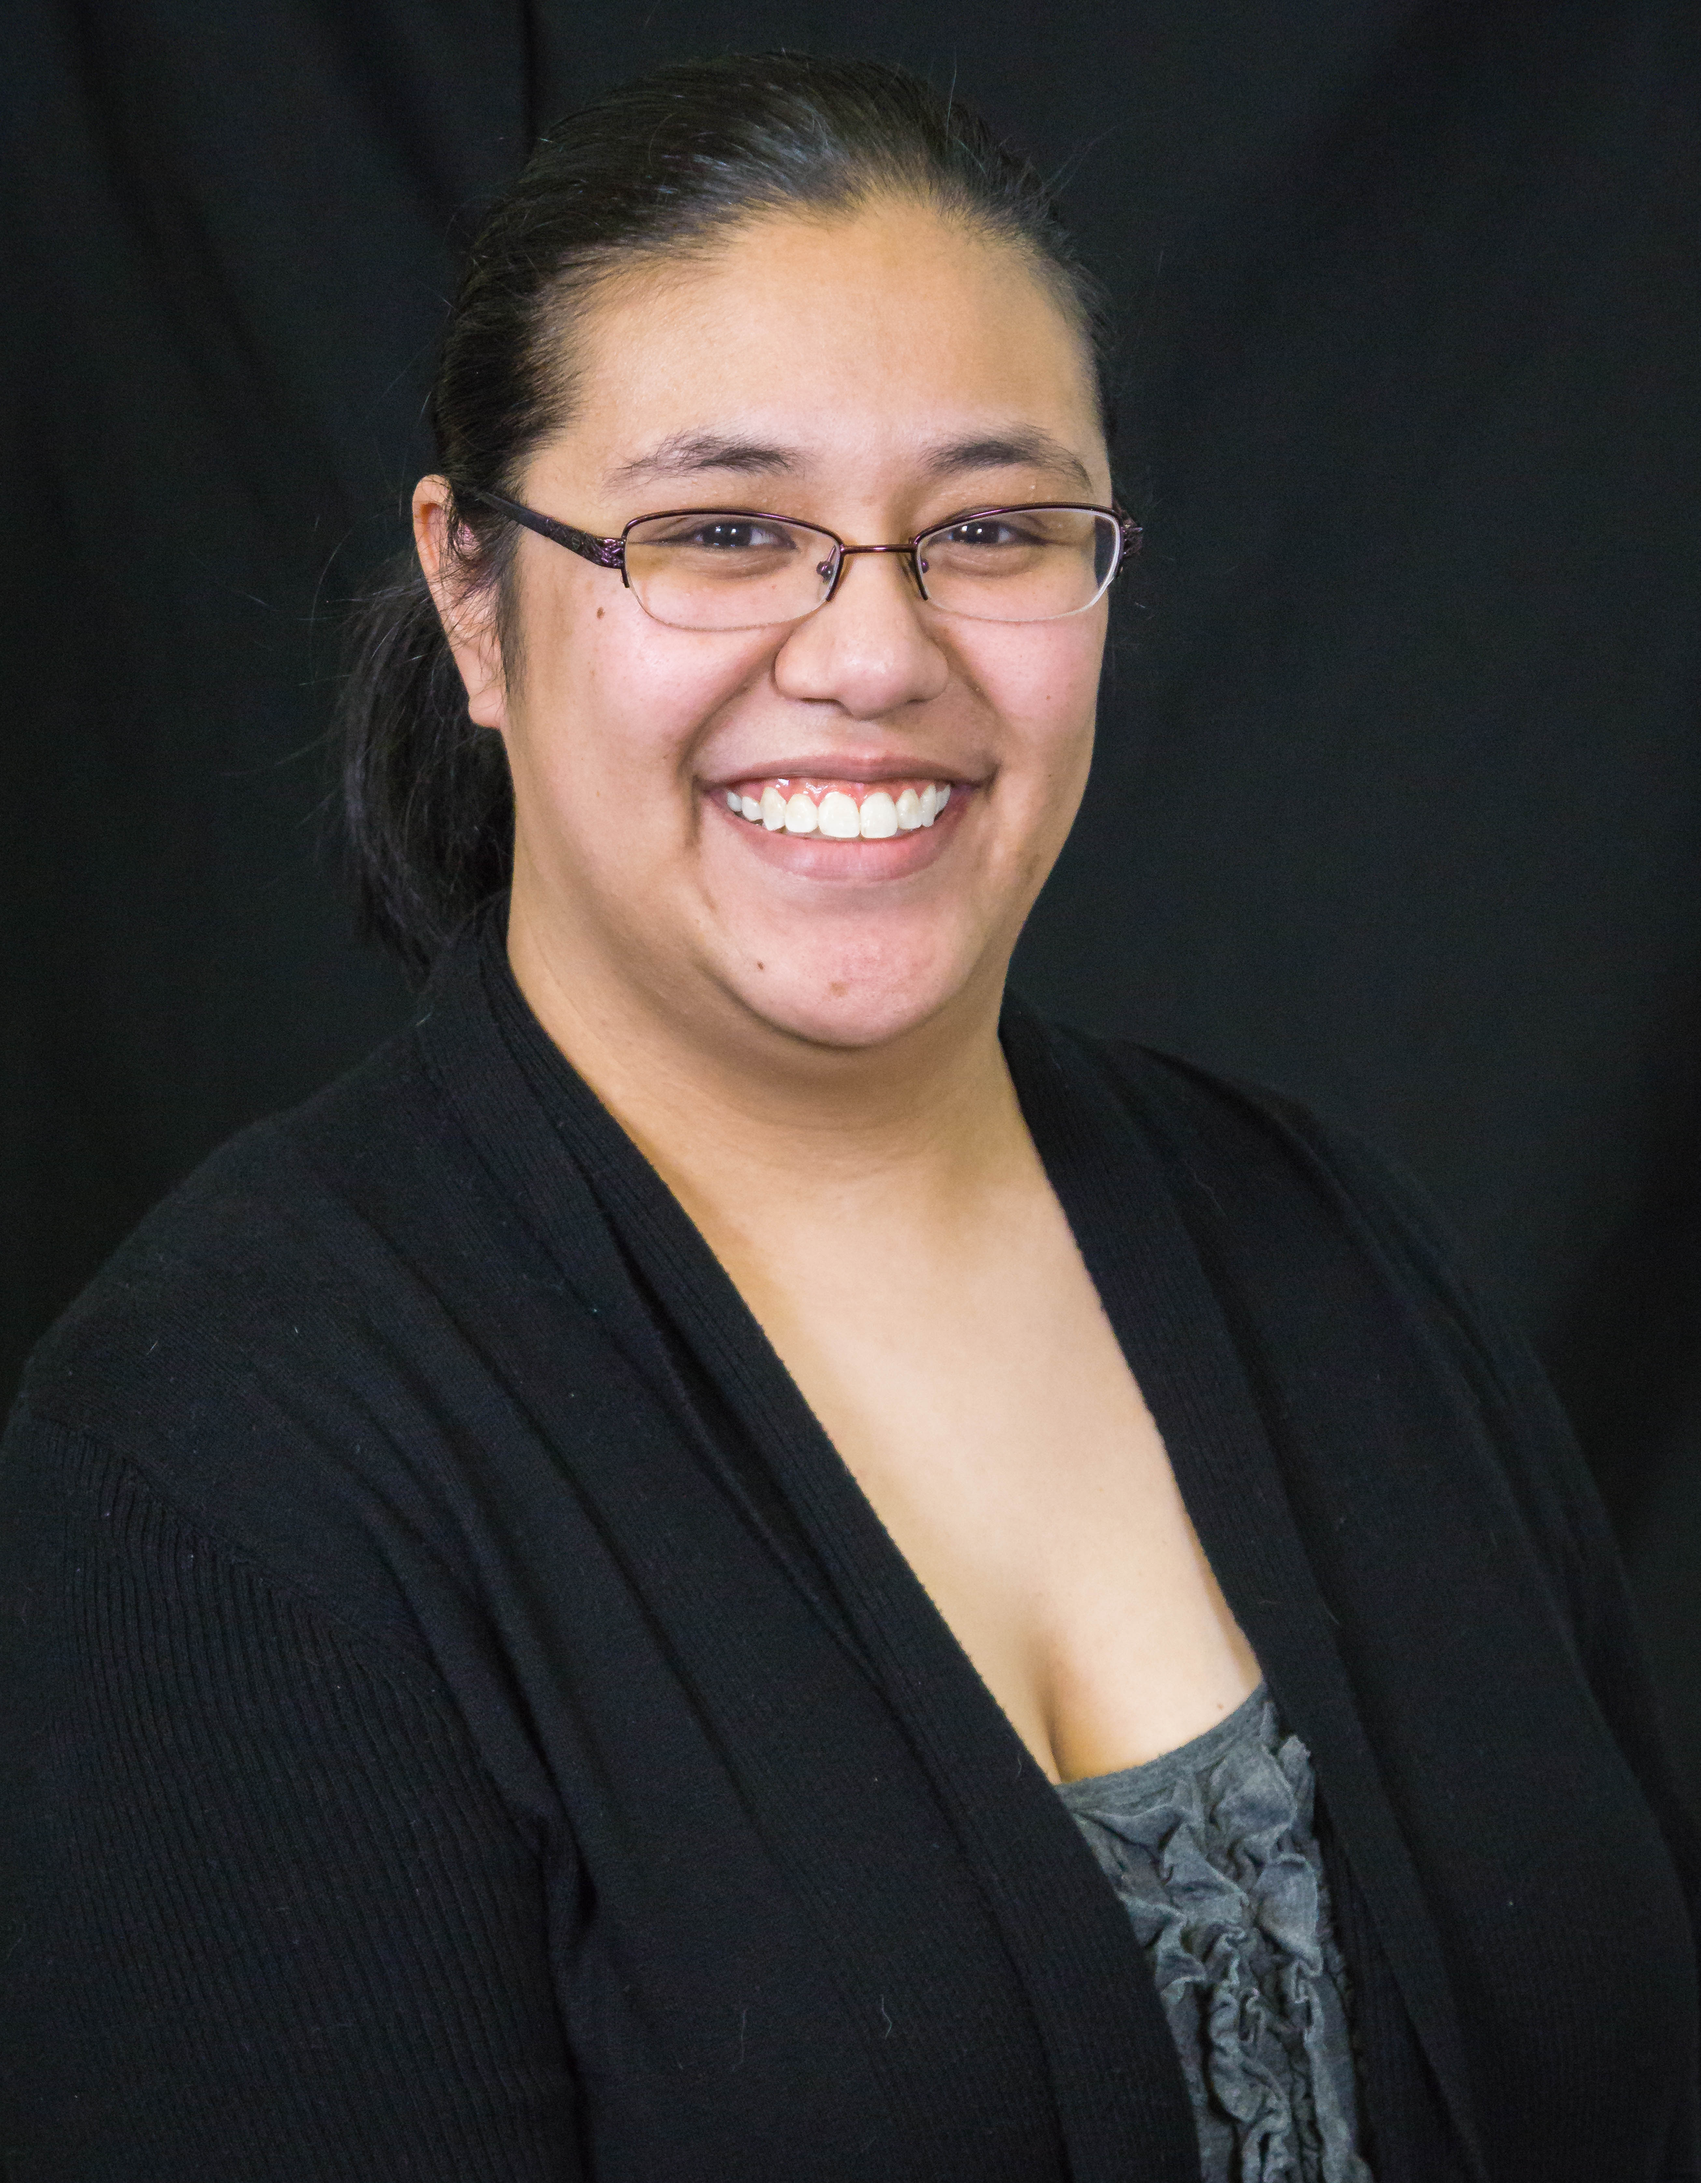
Group 5 – Vacation –Decision Under Making Uncertainty
Team 5 – Student Consultants
Shalini Bagadhi
MSBA Student @ UW Tacoma Project Manager
Identify Problem
TBANLT550
(Project Guide/Faculty)
Choose & Implement Decisions
Shephali Jain MSBA Student @ UW Tacoma Identify Problem
P
G
5
Teja Alluru
MSBA Student @ UW Tacoma Establish & Weigh Decisions
R
U
Evaluate
Alternatives
O
Establish & weigh Decision
Shilpi Karmakar
MSBA Student @ UW Tacoma Generate & Evaluate Alternatives
Dr. Alireza Boloori
Analytical Decision Making
Generate Alternatives
Marion LaRocque
MSBA Student @ UW Tacoma Choose & Implement Decisions

Slide 4

Project Overview – Background & Objectives
Background
Risks and uncertainty in travel/vacation planning .
Travel Lockdowns, Flight Cancelations, Pandemics, Uncertain Conflict Situations
Goal & Scope
Identify best decision based on available options/data.
Sensitivity analysis of uncertainty in output.
Ref: https://encrypted-tbn0.gstatic.com/images?q=tbn:ANd9GcTW9N_vjPVVajUXmq5pTX9aHlhaOTvGPocHVA&usqp=CAU

Slide 5

Uncertain Scenarios
Covid Testing-Positive.
Flight Cancellation.
What if Scenarios.
Ref: https://www.youtube.com/watch?v=ypEqN7ku8Hs

Slide 6
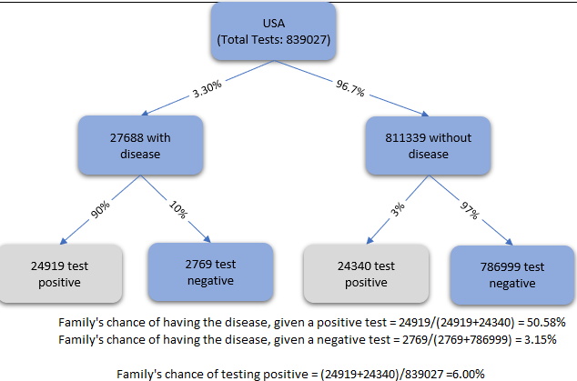
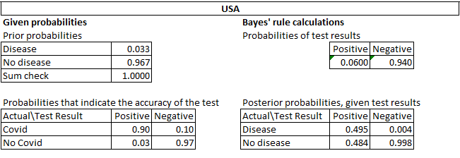
Data Evaluation
Data Required for the Project
Best Destinations Data
Covid Data
Flight Cancellation Data
Trip Cost Data
Data Collection Spreadsheet

Slide 7
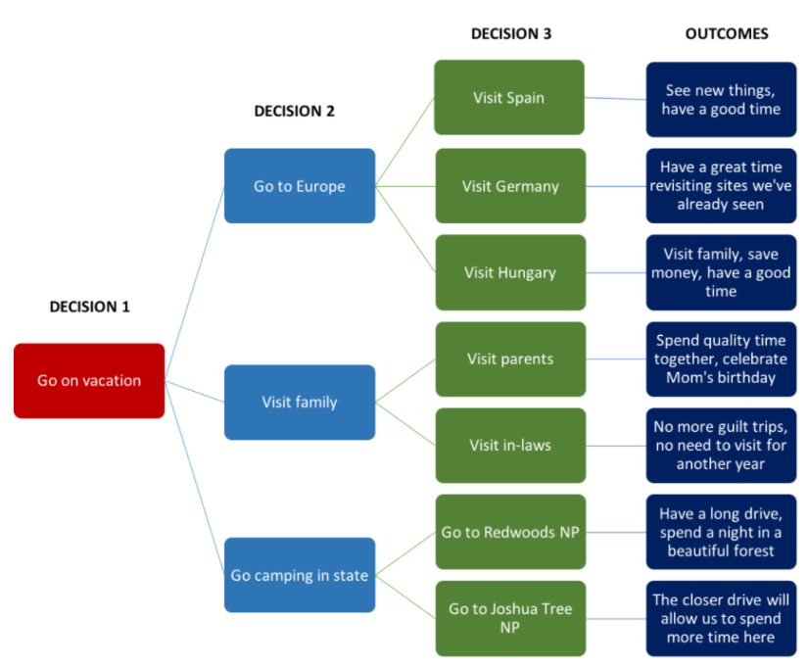
Evaluation Methods/Measures
Decision Tree
Best Strategy or Most Likelihood event based on probability.
Minimizing Loss under uncertainty
https://courses.lumenlearning.com/suny-principlesmanagement/chapter/using-a-decision-tree/

Slide 8
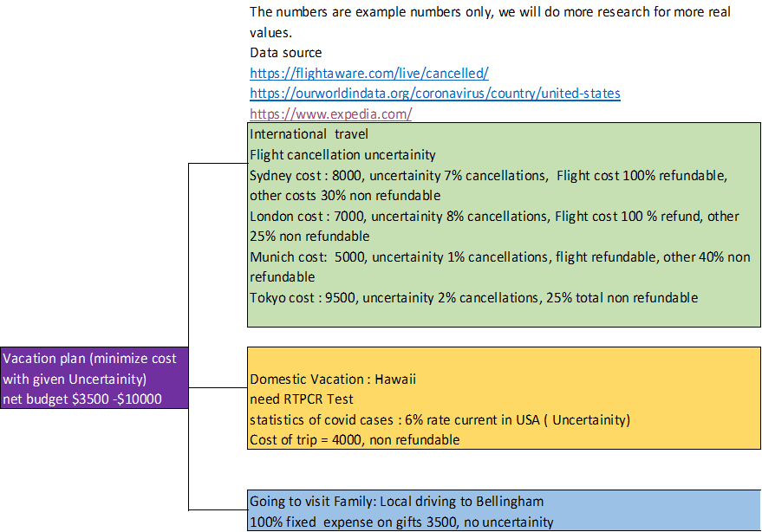
Decision Criteria/Alternatives
Domestic Travel, International Travel or Visiting Family Locally
Cost for the Alternatives
Uncertainty in Alternatives

Slide 9
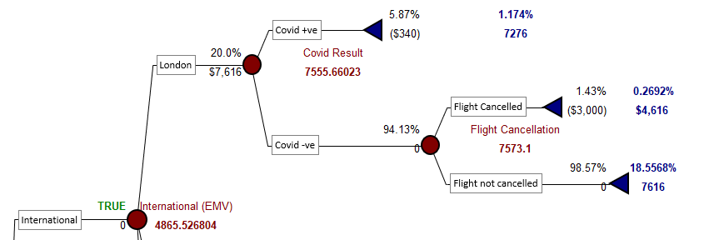
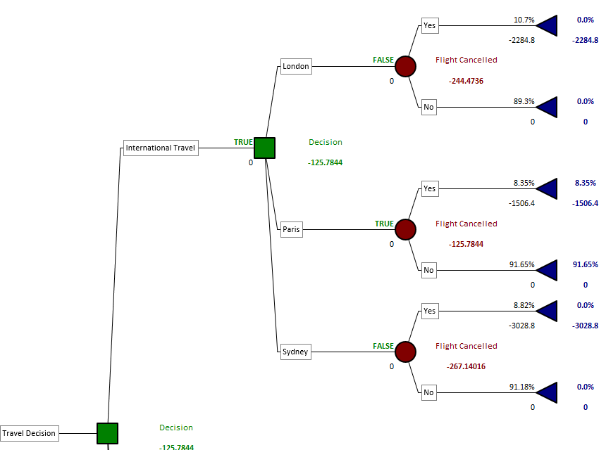
Figural Models
Model 1 – Complex
Model 2 – Simple
Future Models

Slide 10
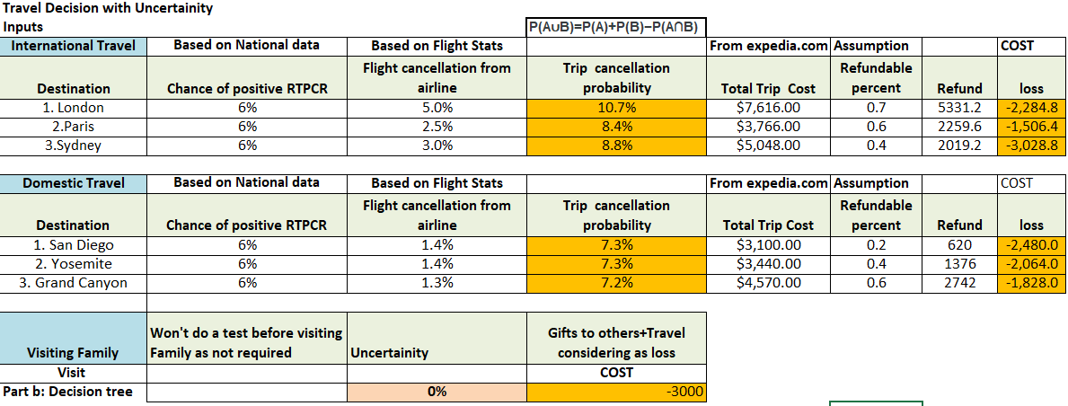
Best Model - Data
Probability of getting Positive RTPCR test = P(A)
probability of airline cancelling the flight due to other reason ( war / weather / regulation change) = P(B)
Probability of both happening at the same time= P(A)* P(B), since
P(A) and P(B) are independent
Probability of Trip Cancellation = P(A∪B)=P(A)+P(B)−P(A∩B)

Slide 11
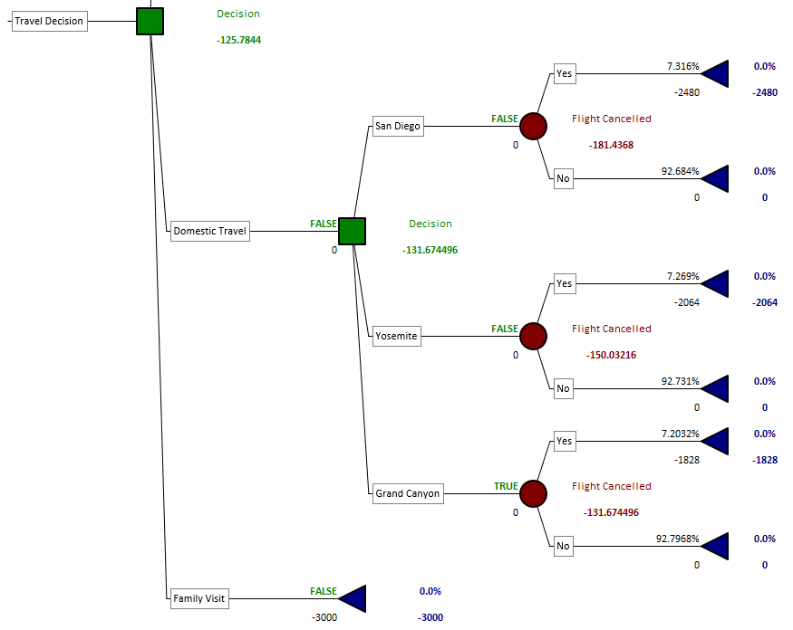
Best Model – Precision Tree

Slide 12
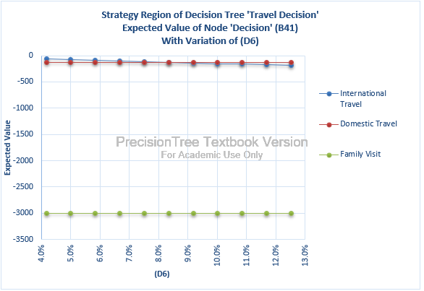
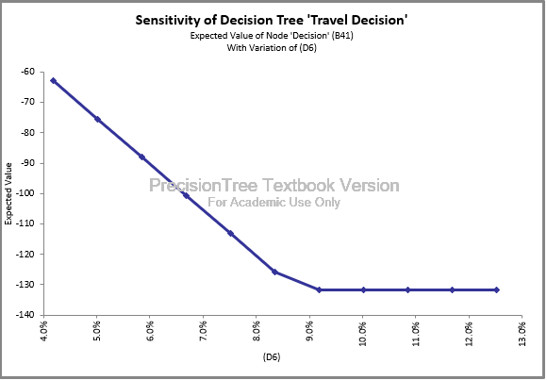
Sensitivity Analysis
.
Sensitivity: 1. What happens if the trip cancellation probability of Paris varies +/- 50% of the base value.?
Tab: Strategy D6: International travel is still the best option as long as Paris trip cancellation probability is less than around 9.2%, if higher, preferred domestic. See Figure 7‑1 below

Slide 13
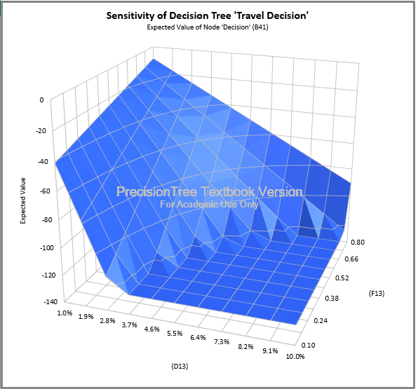
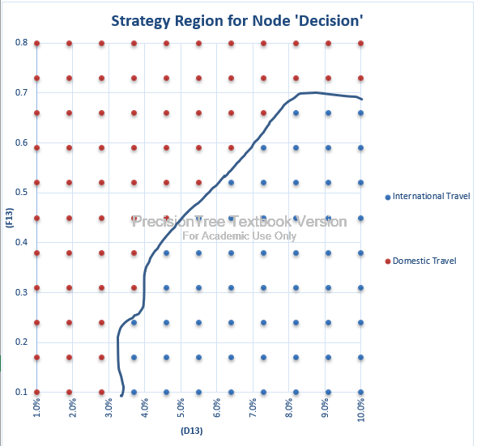
Sensitivity Analysis
.
Sensitivity: 2. Two way: Trip cancellation probability 1-10% and Refund 0.1-0.8% for Grand Canyon
Please see tab: Strategy Region D13, F13. Interesting point. If the refundable percent is 70% and above Grand Canyon is preferred Even if the Trip cancellation probability is 10%.

Slide 14
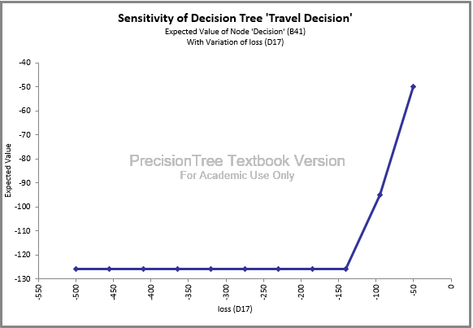
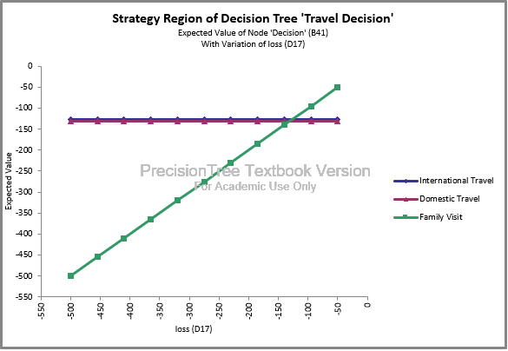
Sensitivity Analysis
.
Sensitivity: 3. What if John Smith does not need to take a gift? Only road trip cost 50 -500 USD
Tab: Strategy D17: Family Visit would be the best option if John Smith does not buy gifts for the family and keep the trip cost to less than $125.

Slide 15
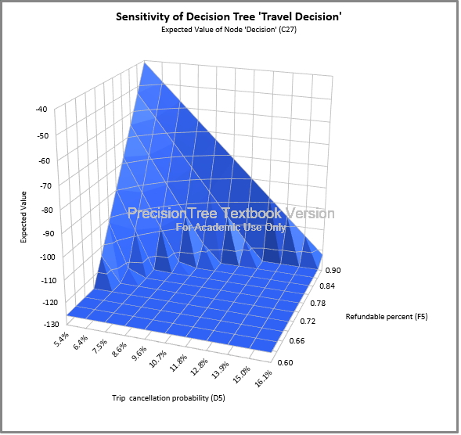
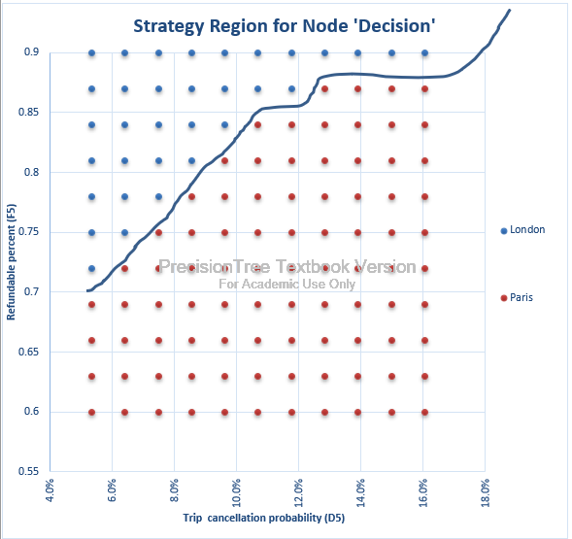
Sensitivity Analysis
.
Sensitivity: 4. Two Way: What happens if the trip cancellation probability of London varies +/- 50% of the base value. And refund varies between 0.6 to 0.9? Is Paris still preferred?
Tab: Strategy region D5 F5: Shows the ranges of Trip cancellation and Refund values when London is preferred. For example, for the current refund rate (0.7), if the trip cancellation is less than 6%, London would be preferred.
.

Slide 16
Next Steps
What is the uncertainty involved if we catch covid after reaching the destination? What is the cost effect involved?
Depending on the cost effect calculated above is it advisable to take a full covid travel insurance coverage or not?
Detailed analysis on alternate decision.
Getting updated data.

Slide 17
Q & A
For further details on project, please contact any of our team members:
Name | Email
Kiran Tejaswi (Teja) Alluru | akteja@uw.edu
Shephali Jain | jainshep@uw.edu
Marion LaRocque | mtib76@uw.edu
Shilpi Karmakar​ | shilpikb@uw.edu
Shalini Bagadhi | shalinib@uw.edu

Slide 18


Thank You

